Slide 1
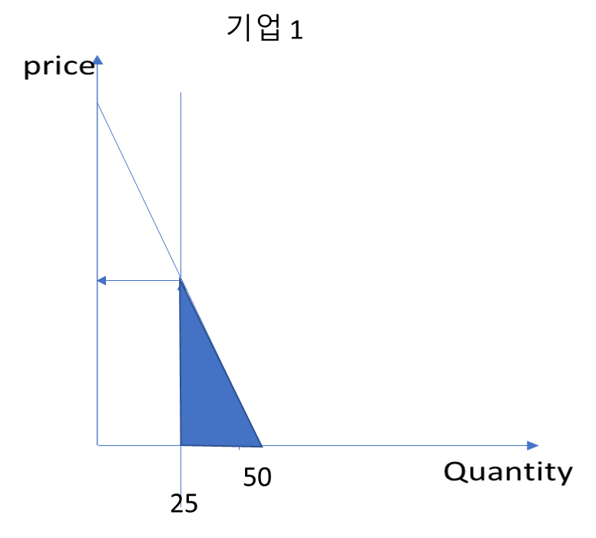
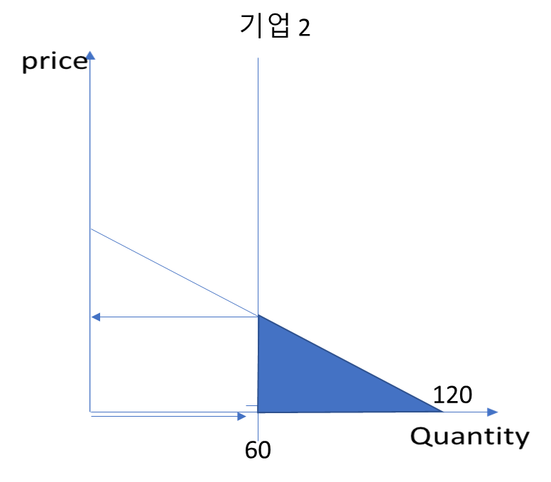
Firm 1, & 2 discharge 50 and 120 units of pollution, respectively.
Command & Control Policy
Gov’t commands each firm to reduce the pollution discharge into half of the previous level
In this case, marginal abatement cost (MAC) for each firm is measured by the red vertical arrows!
Total abatement cost to reduce 25+60 = 85 units of pollution in this market with two firms are represented by blue triangles
Firm 1
Firm 2
(1)

Slide 2
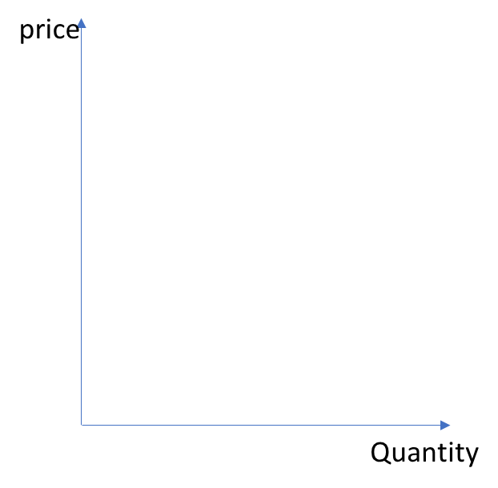
(2) Market Based Policy 2: Tradable Pollution Permits
Gov’t , now, issues certificates of allowed emissions discharge as half of previous pollution level, or 85 of supply of pollution certificates.
Market equilibrium price, P^{E} , will be determined by market demand with given supply.
Firm 1: Pollution Certificate price is cheaper than its marginal abatement cost, therefore, purchase the certificate to discharge. Or Emissions reduction level will be decreased, that is, it will discharge more that before (by the amount indicated by ) until the MAC is equal to P^{E}.
Firm 2. Since Market certificate price is higher than its own MAC, by reducing additional pollution units , it will be able to sell the un-used certificate at the market to get additional benefit until its MAC becomes equal to P^{E}.
(2)
시장
Firm 1
Firm 2
market
Market
Equilibrium price of pollution
(P^{E})
85

Slide 3
(2)
시장
Firm 1
Firm 2
market
Market
Equilibrium price of pollution
(P^{E})
85
Avoided cost
Or
Additional Benefit of not paying for cost of reduction
Additional cost to reduce
It is easy to see that the area for additional benefit
is bigger than that of
additional cost

